Slide 1
Creating Web Content
(CSC-118)
Project

Slide 2
Division of Marks
Class Tests 15
Assignments 10
Mid Term Tests (2) 25
Project 10
Final Exam 40

Slide 3
Project
To be done in groups of up to 4 students
  CV and Website development
  A detail presentation on your project along with viva

Slide 4

Project (CV Part)
Design a main page first that contains the names of all 4 members of a group with their picture and links which will navigate to their respective CV/portfolio page
In total you are required to make 5 web pages. The first page should look as follows:
Student 1
Link
Student 2
Link
Student 3
Link
Student 4
Link

Slide 5
Project (CV Part)
The CV page you can design according to your choice. For that, check different CV templates on the web and pick the one.

Slide 6
Project (Website)
Identify the small business in your family/friend circle and design the website for it
The website must contain at least 5-6 pages
The marks will be given on the basis of individual effort

Slide 7
Content
Focus on the look and feel of the website more than the content, however you will need some content to create the look and feel, so
  Use creative text content
  Make use of graphical content. Work on the aesthetics.

Slide 8
WRITE COMPLETE CODE YOURSELF. PLAGIRISM WILL RESULT IN ZERO MARKS.

Slide 9
Website
Use of Bootstrap, templates, scripts etc. allowed as long as you
  Use resources as per their license
  Give proper credit
  Can make changes to your website during your evaluation

Slide 10
Plagiarism
All ideas that you take from somewhere else must be properly credited
Replication should be clearly indicated with quotation marks
Definitions, diagrams etc. if reproduced used should always be credited

Slide 11
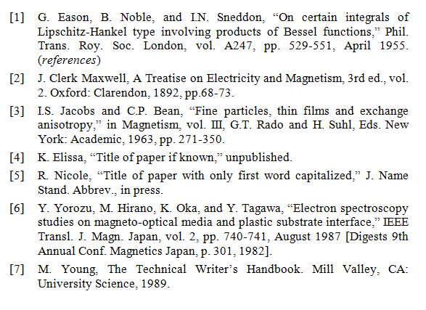

Reference List Sample

